Slide 1




Slide 2
Welcome to the RGS Mathematics Department
Year 11 Options Evening
Tuesday 22nd November 2022

Slide 3
A Level Mathematics
Pearson Edexcel board
Pearson Edexcel Level 3 Advanced GCE in Mathematics (9MA0)
Year 12: Content taught is all AS Pure, some A2 Pure and AS Mechanics (Applied Mathematics).
Year 13: Content taught is A2 Pure Mathematics and Applied Mathematics (AS & A2 Statistics and A2 Mechanics).
Summer work between Year 11 and Year 12 – ‘Pre-Sixth form study pack’ is required of the students. Students are tested on this material at the start of Year 12 (Y12 Algebra test)
Strong algebraic skills required to succeed at Maths A-level
Entry requirement is a Grade 8 at GCSE.

Slide 4
A Level Mathematics
All external exam assessments are in the Summer term of Year 13. External examinations in May/June 2025 for 2023 cohort.
No AS Mathematics option.
A-level Mathematics is 100% exam, no coursework.
All exams are equally weighted (3 exams worth 100 marks each)
Your UCAS prediction will usually be your grade from Year 12 End of Year UCAS exams, also taking into account termly assessments and January mock performances.
Larger emphasis on Mathematical Proof & Reasoning, Problem-Solving and Mathematical modelling

Slide 5
Keys to Success in Maths A-level
Strong Maths dept: 12 Extremely dedicated & hard-working Maths teachers
8 enthusiastic & committed Maths Subject Ambassadors
Students take ownership of their learning; big difference between Maths GCSE and Maths A-level is that the homework set is the ‘bare minimum’ level of independent work required to succeed.
Do not pick Maths ‘because you need it’ or your parents tell you to do it; do it because it excites you and you are passionate about Maths

Slide 6
Keys to Success in Maths A-level
Level of independent work required to succeed at Maths A-level is much higher. Expectation that students MUST put lots of time & effort into their ‘own learning’
Maths A-level new specification is focused on Mathematical Proof & Reasoning; strong algebraic skills required to succeed at Maths A-level
Greater focus on Problem-Solving skills, and applying Mathematical concepts to models
Much greater level of detail required in written solutions
Do not pick Maths or Further Maths if you are ‘struggling’ for a 4th choice

Slide 7
A Level Mathematics
3 external exams at end of Year 13.
No re-sits
All exams are equally weighted.
All exams are calculator.
AS Further Mathematics may be available in Year 13 for students who want to study Maths at a Higher level and beyond their RGS years (criteria is an A* UCAS Prediction)
Lessons taught by two teachers (6 periods in Year 12) and two teachers in Year 13 (7 periods).

Slide 8
Tradition of excellent results in both Maths and Further Maths A-level. 85.6% A*-B in Maths, 100.0% A*-B in Further Maths in 2022. 88.7% overall (84.3% overall in 2019)
Tradition of a large cohort taking Mathematics
A-level (currently 150 students in Year 12 and 125 in Year 13; 132 students in 2022 and 136 in 2021)
Support and guidance:
Maths mentoring, support sessions, and revision sessions.

Slide 9
A-level Further Mathematics
Pearson Edexcel board
Pearson Edexcel Level 3 Advanced GCE in Mathematics (9FMA0)
Year 12: A-level Mathematics specification is taught by 4 teachers (except A2 Statistics) & AS Core Pure 1.
Year 13: A-level Further Mathematics specification is taught by 3 teachers (Core Pure 2, Further Pure 1 and Further Mechanics).
Summer work between Year 11 and Year 12 – ‘Pre-Sixth form study pack’ is required of the students.
Entry requirement is a Grade 9 at GCSE or high Grade 8 together with minimum grade C in FSMQ Add Maths, or minimum grade 7 grade in AQA Level 2 Further Maths.

Slide 10
The difference between Maths
& Further Maths
Number of exams taken:
  Maths –3 exams at end of Year 13, each 2 hours studied over 2 years.
  Further Maths – 4 exams at end of Year 13, each 1 hours 30 minutes, studied in Year 13.
Number of lessons per week:
  Maths - 6 periods in Year 12 and 7 periods in Year 13, shared between two teachers.
  Further Maths – 12 periods in Year 12 shared between four teachers, and 14 periods in Year 13 shared between three teachers.
UCAS:
  Maths is counted as a single A-level.
  Further Maths is counted as 2 A-levels if all 7 exams taken. No Further Maths (Additional) is available.

Slide 11
Resources available:
Pearson Activelearn Digital textbook
Edexcel Practice and Past Papers
Integral Maths (free individual login for every Year 12 & 13 Maths student)
MyMaths, Mathsbox
Underground Mathematics
Dr Frost Maths, COMPOS
What is new?
New emphasis on technology: Casio fx-CG50 Graphic calculator recommended (available to purchase through the school at discounted price)
New emphasis on ‘Large data set’ in Statistics

Slide 12
Maths Activities:
Maths mentoring (great for UCAS reference)
Maths Challenge Club
Maths Battles (organized by www.wesolveproblems.org)
Senior Maths Challenge
UKMT Senior Maths Challenge Team Competition
Hans Wodya team competition
House competition
Ritangle Team Competition
University support:
Help and guidance with Maths-based UCAS Personal Statement
Mock University Interviews

Slide 13
2022 Results – Mathematics
2022 | A* | A | B | C | D | E | U | Total
Maths | 65 | 33 | 15 | 12 | 4 | 3 | 0 | 132
RGS% | 49.2 | 25.0 | 11.4 | 9.1 | 3.0 | 2.3 | 0
RGS cumulative % | 49.2 | 74.2 | 85.6 | 94.7 | 97.7 | 100 | 100
Edexcel national data cumulative % | 22.2 | 46.6 | 62.5 | 77.6 | 90.1 | 97.8 | 100

Slide 14
2022 Results – Further Mathematics
2022 | A* | A | B | C | D | E | U | Total
Further Maths A-level | 20 | 13 | 3 | 0 | 0 | 0 | 0 | 36
RGS % | 55.6 | 36.1 | 8.3 | 0 | 0 | 0 | 0
RGS cumulative % | 55.6 | 91.7 | 100 | 100 | 100 | 100 | 100
Edexcel national data (cumulative %) | 38.4 | 66.0 | 82.3 | 92.1 | 97.1 | 99.1 | 100
Further Maths AS-level |  | 7 | 0 | 1 | 0 | 0 | 0 | 8

Slide 15
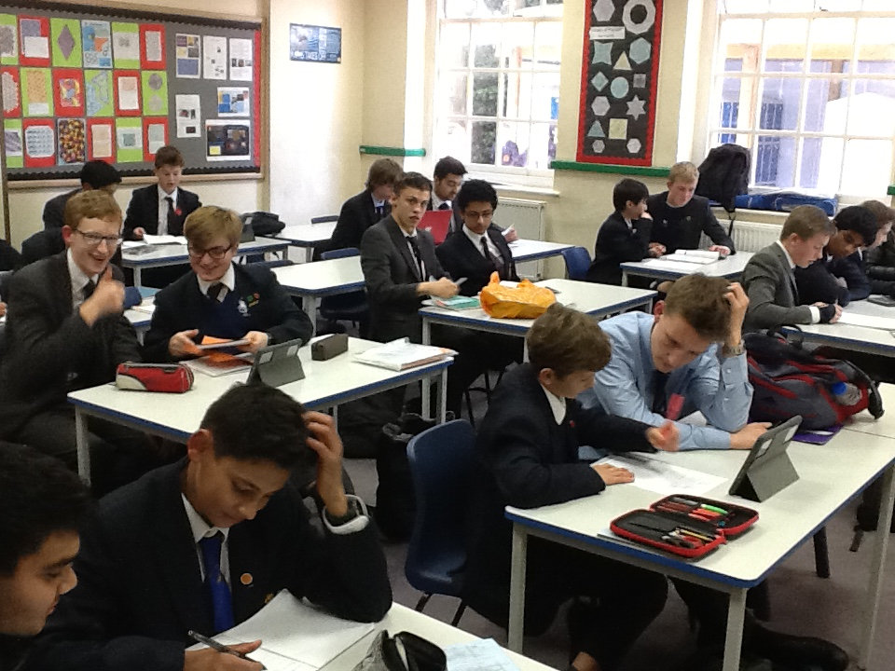
Maths mentoring

Slide 16
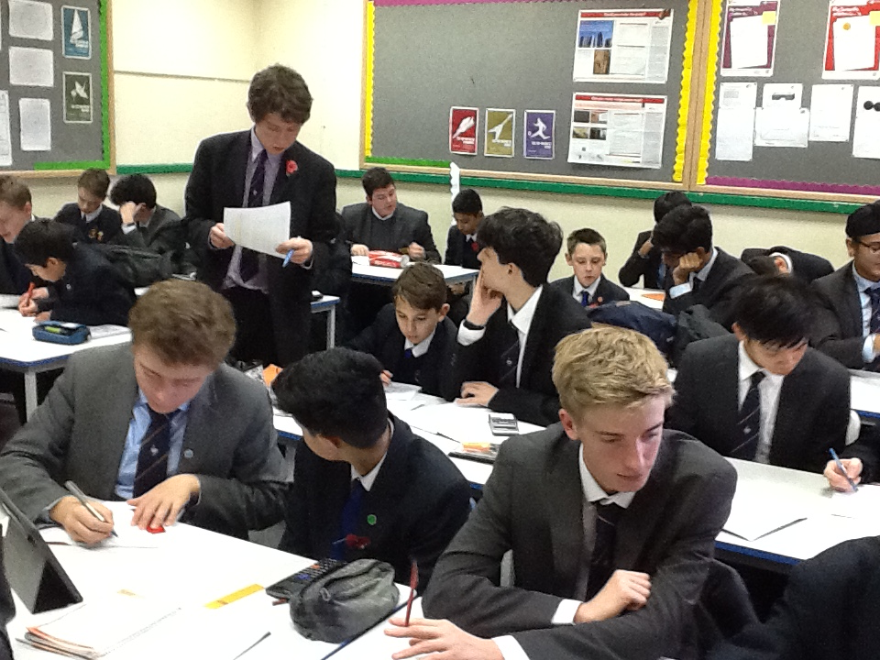
Maths mentoring

Slide 17
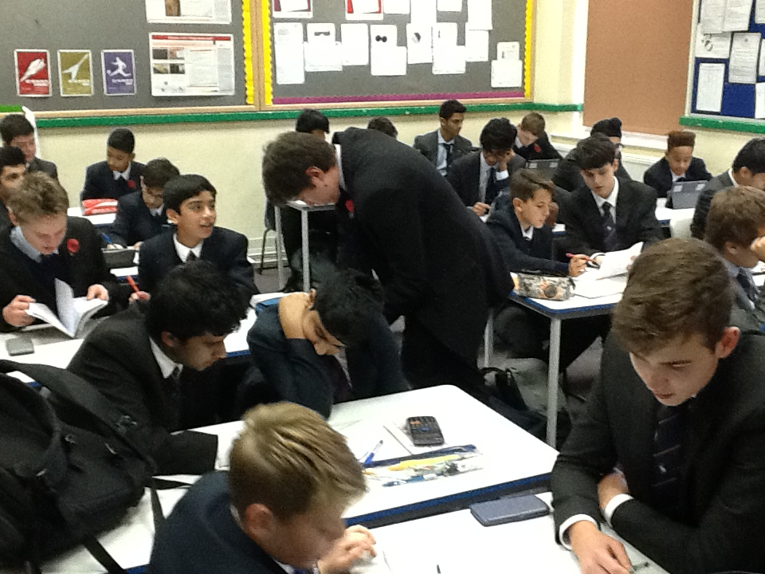
Maths mentoring

Slide 18
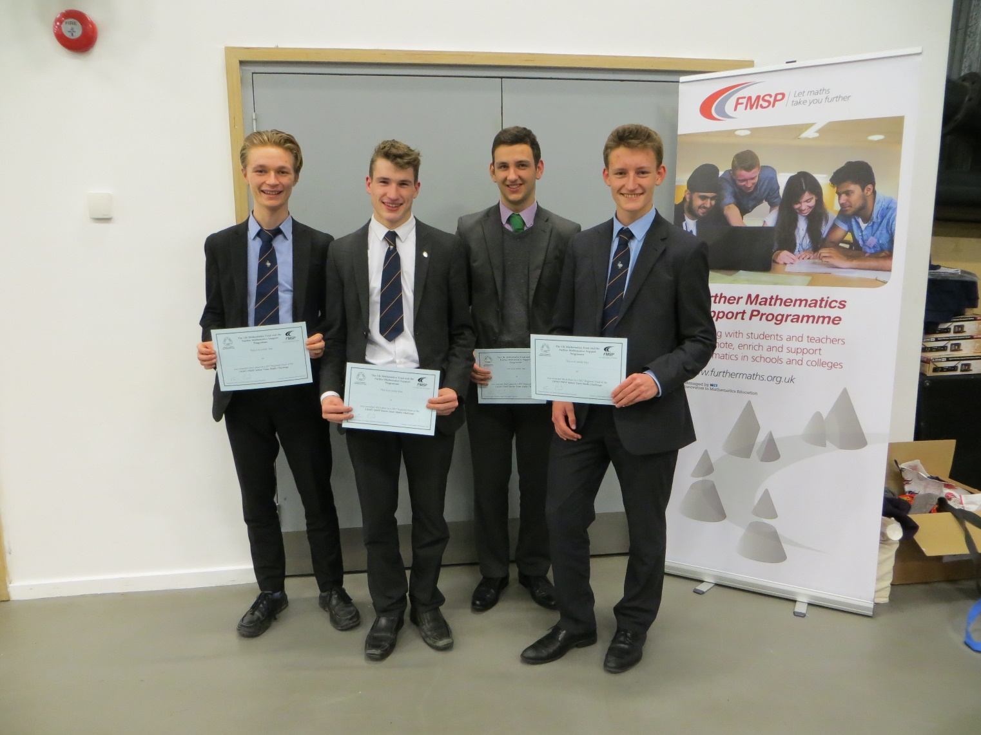
UKMT Senior Maths Team Challenge
(2nd place in 2019 & 2020)

Slide 19
Hans Woyda Maths Team Challenge
National Semi-Finalists

Slide 20
Senior Maths Challenge Nov 2022 (167 Entries):
25 Gold certificates
60 Silver certificates
61 Bronze certificates
25 students through to the next round
(22 Senior Kangaroo and 3 students through to British Maths Olympiad)

Slide 21

A-level Mathematics examinations:
Pure Mathematics 1 | 2 hours | 100 marks | Proof, Algebra and functions, Co-ordinate geometry, Sequences & series, Trigonometry, Exponentials & logarithms, Parametric Equations, Differentiation, Integration, Numerical methods, Vectors
Pure Mathematics 2 | 2 hours | 100 marks
Statistics & Mechanics | 2 hours | 100 marks | Statistical sampling, Data presentation & interpretation, Probability, Statistical distributions, Statistical hypothesis testing, Quantities & units, Kinematics, Forces & Newton’s laws, Moments

Slide 22
A-level Further Mathematics examinations:
Core Pure 1 | 1 hr 30 mins | 75 marks | Proof, Complex numbers, Matrices, Further algebra and functions, Further calculus, Further vectors, Polar coordinates, Hyperbolic functions, Differential equations
Core Pure 2 | 1 hr 30 mins | 75 marks
Further Pure 1 | 1 hr 30 mins | 75 marks | Further trigonometry, Further Calculus, Further differential equations, Co-ordinate systems, Further vectors, Further numerical methods, Inequalities
Further Mechanics | 1 hr 30 mins | 75 marks | Momentum & Impulse, Work, Energy & Power, Elastic stings & springs, Elastic collisions in one and two dimensions

Slide 23
Beyond Year 13
The Russell Group Informed Choices Guide lists Maths and Further Maths as subjects required for University courses more often than others, referred to as facilitating subjects.
Requirement for some university courses for example: Engineering, Physics, Psychology, Economics, Computing, and Business Studies prefer students to have A Level Maths.
As a traditional subject, a good grade in Maths can boost an application for pretty much every course!

Slide 24
Remember…
You have to study Maths to be a Mathematician, but you don’t have to be a Mathematician to study Maths!
If you study something you enjoy, you are likely to do better at it.
Do NOT study a subject just because you think it looks good on your CV; make sure it is a subject that you are enthusiastic about and will be committed

